Slide 1

Department of Computer Engineering & Applications
GLA University
Mathura- 281406, INDIA
2020-21

Slide 2
IoT Project Presentation on
WATERIOT
Advance IoT based smart water purifier.
By :
Anand Khandelwal (74/ 181500090)
Md Rashid (47/ 181500381)
Vishes Keshari (62/ 181500813)
Supervised By:
Mr. Ajitesh Kumar
(Assistant Professor)
Department of Computer Science and Engineering

Slide 3
Introduction
Internet of Things is serving as a growing structure to almost every field in this era of Industrialization4.0. It is a concept of integrating sensors and components in machines that can communicate with each other via internet. This makes the industry more efficient and synchronized.
Nowadays water purifying machine an essential home appliance due to increase in pollution of water. It filters unwanted minerals and chemicals from the raw water and make it fit for consumption by human body. There are many companies that are actively manufacturing and supplying these water purifying machines in the market. However, there are various scope of betterment in these machines by implementing the concepts of Internet of Things. With the help of IoT, we can-do real-time data monitoring and control the working of the water purifying machines will increase the life of the machine.

Slide 4
Objective
This invention is a smart water purifier. The main objective of it is to use Internet of Things and various sensors in different segments of the purifier to monitor and control their working in real-time.
Sometimes water purification motor runs despite of having no water inlet. This results in burning of the motor circuit. The first module of the invention solves this problem by checking the flow of water inlet using Water Flow Sensor and 7 signal to user’s smartphone when water flow anyhow stops. User can then cut power flowing to the motor. This will also prevent the wastage of electricity that is going to be used by the motor.
In almost every purifier, the purifying device runs on its own and have fixed parameter of water level on which it runs. But it results in wastage of electricity and potential of purifier. So, this invention will use ultrasonic sensor that calculates the water level and user can dynamically set the water level parameter o which the purifier will run.
In normal purifiers, we get the fixed water purifying rate and speed which does not vary on the basis of water quality and ultimately reduce the performance level of the purifier. So, this invention will use a smart regulator connected with our mobile device through cloud and by which user can control the purifier’s rate and speed according to the water quality. On the conclusion we simply mean to save electricity and water and ensure longevity of the water purifier and make it more feasible to use and control from anywhere.

Slide 5
Requirements

Slide 6
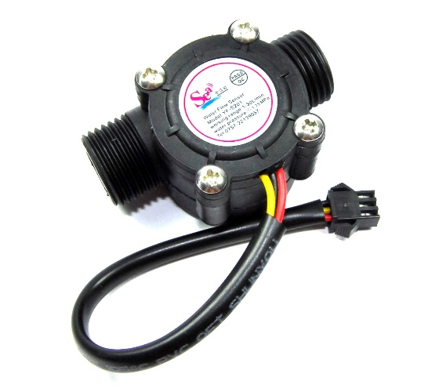
Water Flow Sensor:
Water flow sensor is made up of hard plastic body, a water rotor, and a hall-effect sensor. When water flows inside the valve body of the sensor through the rotor, the rotor rotates and its speed varies with different rate of flow. The hall-effect sensor generates the corresponding pulse signal. The most common way to calculate liquid flow rate is actually identical to the principle of measuring the velocity of wind by an anemometer: the velocity of wind is directly proportional to the rotation speed of the anemometer. The prime part of this type of flow sensor is a type of a pinwheel, whose speed is proportional to the flow rate of liquid passing through it. Checking the rate of flow of water inlet using Water Flow Sensor and sends signal to user’s smartphone when water flow anyhow stops. User can then cut power flowing to the motor. This will prevent motor from burn down due to unnecessary running even if water flow is zero and this will also prevent the wastage of electricity that is going to be used by the motor.

Slide 7
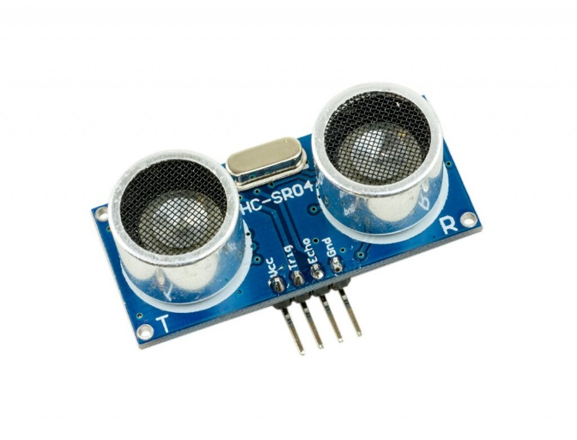
2. Ultrasonic Sensor:
The ultrasonic sensor is used to calculate the distance of a particular object by emitting ultrasonic sound waves, and converting the reflected sound into an electrical signal. An ultrasonic sensor consists of two main working parts: (1) The Transmitter: Transmitter is responsible of emission of the sound waves using piezoelectric crystals. (2) The Receiver: Receiver encounters the sound after it return back by hitting the target. It checks the level of purified water in the tank and based on that user can dynamically set the water level parameter on which the purifier will run which reduces the wastage of electricity and water, and increase potential and longevity of purifier.

Slide 8
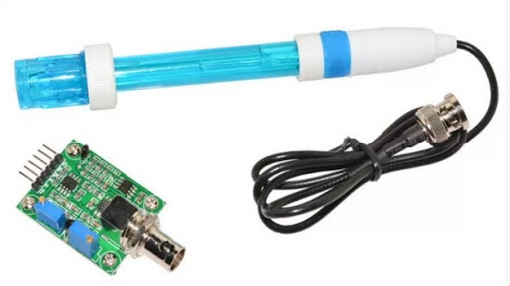
3. Water Quality Sensor:
pH sensor measures the acidity or alkalinity of the water on the scale of 0-14. When the pH value falls below 7, the water starts to become more acidic and any number above seven indicates more alkaline. Different types of pH sensor work differently to measure the quality of the water. pH meter in pH sensor basically measures the hydrogen-ion activity in water-based solutions by calculating the difference in electrical potential between a pH electrode and a reference electrode and it sometimes also called as a "potentiometric pH meter". The measurement indicates the acidity or alkalinity of water. Using Water Quality Sensor user can monitor the quality of water and based on that can control the purifying rate and speed. It can be used in many area like in laboratories, water source quality control, etc.

Slide 9
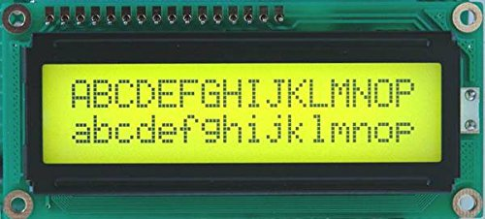
4. 16 x 2 LCD Module:
Liquid Crystal Display (LCD) not only provides user interface but also used for debugging purpose. HITACHI 44780 which provides a simple interface between the controller & an LCD is the most common type of LCD controller. These LCDs are simple to interface with the controller and cost effective. The LCD has 3 control lines (RS, R/W & EN) & 8 (or 4) data lines. The total number on data lines depends on the mode of operation. 8-bit mode of operation requires 8 data lines + 3 control lines i.e., 11 lines in total. And 4-bit mode of operation requires 4 data lines + 3 control lines i.e., 7 lines in total. We decide the mode of use on the basis of availability of data lines.

Slide 10
Technology Used

Slide 11
Raspberry Pi
Raspberry Pi is basically a set of single board small computers developed specially for IoT applications by the Raspberry Pi Foundation in association with Broadcom (United Kingdom) . It is an IoT development device that has embedded micro-processors and micro-controllers in it. It has its own operating system which is recommended for applications of IoT. Raspberry Pi is a free OS based on Debian, and optimised for the Raspberry Pi hardware. With over 35,000 packages, Raspberry Pi OS comes as a precompiled software bundled in a optimise format for easy installation on Raspberry Pi. Raspberry Pi Operating System is in an active development. Since it is a community project, developers’ emphasis on improving its stability and performance by adding as many Debian packages as possible.

Slide 12
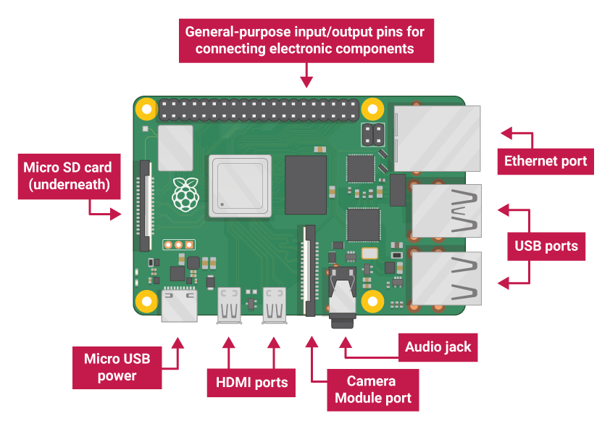

Slide 13
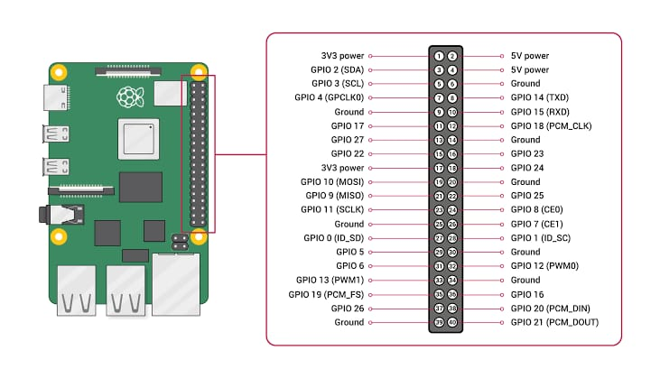
Fig. Raspberry-Pi Pin Diagram

Slide 14
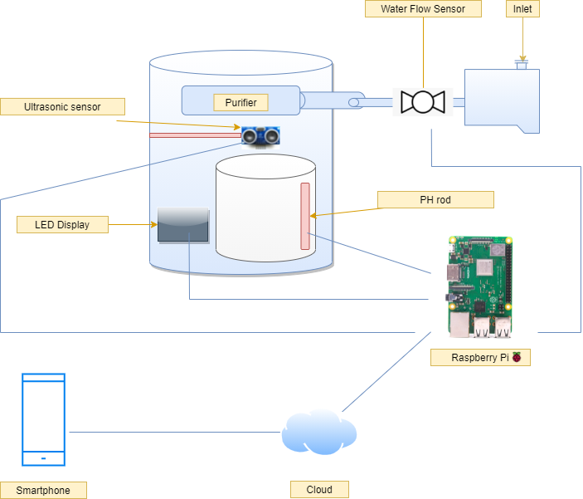
Proposed Model

Slide 15
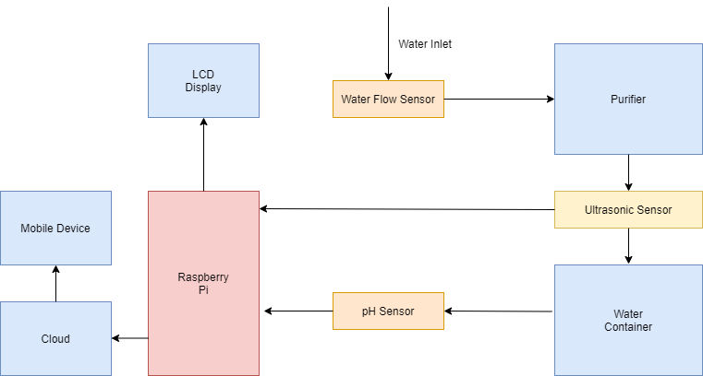
Working Diagrams

Slide 16
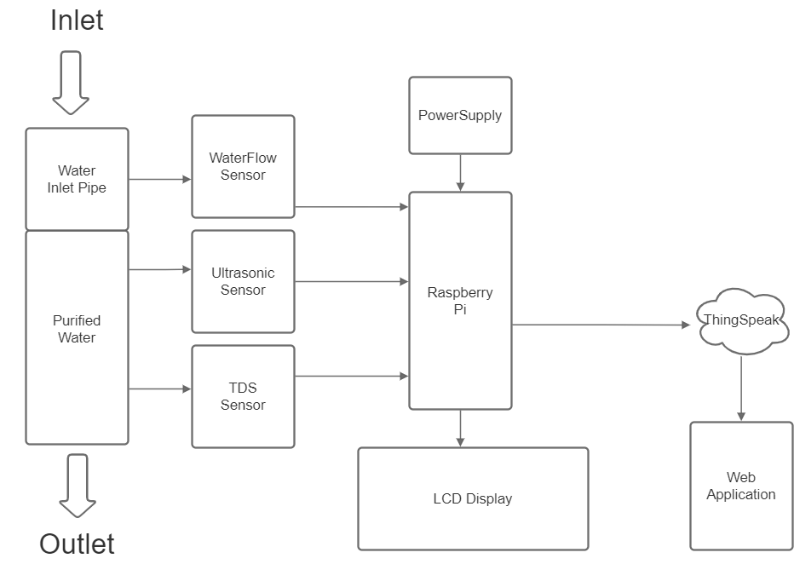
Working Diagrams

Slide 17
Here by using water flow sensor, we will monitor water flow through inlet and prevent unnecessary running of Motor when water is not available and prevent damage of Motor. And by using ultrasonic sensor and pH sensor we will run our water purifier according to our water level and set limit on water container to how much store and collect water and when is time to close the motor and when to open. And according to pH and TDS sensors we will control the purifying speed of purifier and maintain quality of water according to our use and preference. With display implanted on water purifier we will be able to view motor running status and purifying status and pH of water, after implying cloud we will be able to control the Motor and view all its details and features also on our devices.

Slide 18
ALGORITHM:
A finite set of instruction to solve a given problem.

Slide 19
Problem 1. Water Flow Monitoring.
Water Flow sensor implemented on inlet of water purifier will monitor water flowing through it.
If the water flow is feasible so then it will send signal to start the motor Otherwise it will not send the signal to the motor.
This will be continued monitoring through water flow sensor anyhow change will be reflected back.
The Motor will run if first condition is followed and will not run if second condition is followed.
The End result will be displayed on Monitor and send to ThinkSpeak app to display the same and Owner can monitor it.

Slide 20
Problem 2. Water Level Monitoring.
The ultrasonic sensor implemented on top of the purified-water storing vessel. It will detect the distance of water from top of the vessel.
Two parameters will be set.
a) On State
b) OFF State
When Purifier switch is on and after taking result from water flow sensor the ultrasonic sensor will calculate the distance of water from top.
If water level is less than ON state the motor will run automatically and if water level is greater than OFF state the motor will not run and if water level is between them the motor will run and stop once it reaches the OFF state.
The parameters can be set through raspberry pie and reflected on Monitor.

Slide 21
Problem 3. pH and TDS monitoring
The pH sensor and TDS sensor that are implanted in purified water vessel will give continuous reading and will be displayed on monitor and think speak app.
There will be parameter set for pH and TDS and according to them the water purifying speed will be regulated through regulator and this can be set on app and monitor screen.
All the live monitoring will be displayed on LCD screen on purifier and also printed on screen of ThinkSpeak app.

Slide 22
Experimental Result Analysis

Slide 23
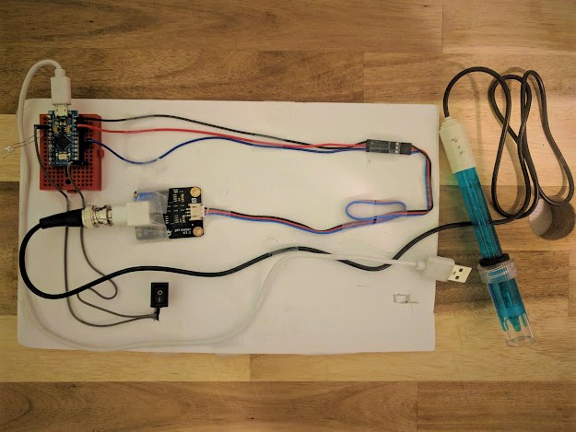
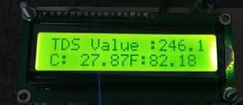
Invention Images :
Fig 1. PH and TDS Sensor setup
Fig 2. TDS Reading

Slide 24
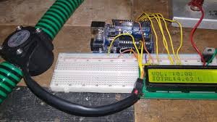
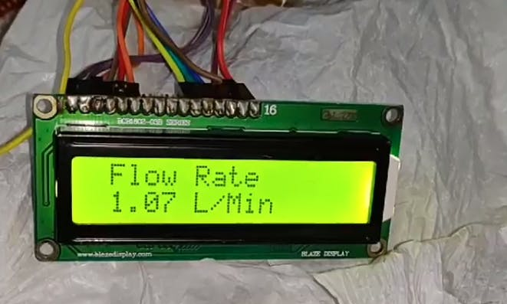
Invention Images :
Fig 3. Water Flow Sensor setup
Fig 4. Water Flow Rate reading

Slide 25
Result Analysis

Slide 26
Table 5.2.1 (for Water Level)
S.no. | Time (in minutes) | Water Level | Distance from Ultrasonic sensor
1 | 0 | 30 | 5
2 | 5 | 24.5 | 10.5
3 | 10 | 21.3 | 13.7
4 | 15 | 14.6 | 20.4
5 | 20 | 9.8 | 25.2
6 | 25 | 5 | 30
7 | 30 | 11.4 | 23.4
8 | 35 | 16.2 | 18.8
9 | 40 | 19.7 | 15.3
10 | 45 | 24.54 | 10.46
11 | 50 | 30 | 5

Slide 27
Table 5.2.2 (for Water Flow Rate through Water Flow Sensor)
S.no. | Time (in minutes) | Wateriot | Volume (in millilitres)
1 | 1 | 858 | 60
2 | 2 | 860 | 160
3 | 3 | 890 | 260
4 | 4 | 876 | 360
5 | 5 | 863 | 460
6 | 6 | 891 | 560
7 | 7 | 857 | 660
8 | 8 | 900 | 760
9 | 9 | 868 | 860
10 | 10 | 883 | 960

Slide 28
Table 5.2.1 with its corresponding graph represents the water level in the purifier at different intervals of time. The level is calculated by the readings of Ultrasonic sensor which measures the distance of top layer of water from it.
Table 5.2.2 with its corresponding graph represents the passing volume of water (in millimetres) per minute duration through the water flow sensor.

Slide 29
Comparison

Slide 30
Table 5.3.1 : Electricity Consumption
S.no. | Wateriot (watt) | Miniature IOT purifier | PureSure
1 | 50 | 50 | 65
2 | 55 | 65 | 55
3 | 40 | 50 | 40
4 | 90 | 110 | 100
5 | 70 | 80 | 90
6 | 130 | 140 | 120

Slide 31
Table 5.3.2 : Water Wastage (in Litres)
Wateriot | Smart Purifier | Purity
5 | 6 | 7
2.5 | 4.5 | 3.5
4 | 4.5 | 5.5
1 | 2.5 | 1.5
3 | 3 | 4
2 | 3 | 3

Slide 32
Table 5.3.3 : Lifetime Expectancy
Purifiers | Life Time (Months)
Smart IoT Purifier | 25
Miniature Purifier | 22
Wateriot | 30
Purity | 24
Smart Water | 26
SurePure | 18

Slide 33
Table 5.3.1 with its corresponding graph compares the total electricity consumption (in watt) in different durations of time by Wateriot to other purifiers.
Table 5.3.2 with its corresponding graph compares the water wastages (in litres) by Wateriot to other purifiers.
Table 5.3.3 with its corresponding graph compares the total life expectancy (in months) of Wateriot to other water purifiers.

Slide 34
Conclusion
The completion of the design that we developed using the water purifier and various sensors in different segments of the purifier to monitor and to control the working of those segments in real-time by using concepts and technologies of Internet of Things makes the exiting models of water purifiers more efficient and extend their working life. All the sensor that are used in this project are affordable and not very expensive. This will not only help the current manufacturers in the market but also the end consumer of the product.

Slide 35
Future Scope
At present stage, we have equipped the Wateriot: Advance IoT based smart water purifier with water flow, ultrasonic and pH-rod sensor with LCD display that monitors and measures the flow, level and quality of water the purifier and then data is sent to the ThingSpeak cloud. Then web page shows data from the ThingSpeak cloud to the user. However, in future the Wateriot can also be equipped with other modern sensors and devices. Further we can analyze the data received from the purifier and use some machine algorithm to take better decision and this will also help us make future decisions about the purifying motor from the past data. Thus, making it more efficient and easier to handle. Hence IoT can help us in bringing cost effective, smart and more efficient technology in future.

Slide 36
References:
https://www.ijeast.com/papers/335-339,Tesma503,IJEAST.pdf
http://www.kscst.iisc.ernet.in/spp/40_series/SPP40S/02_Exhibition_Projects/158_40S_BE_2050.pdf
https://ieeexplore.ieee.org/abstract/document/9336991
https://bit.ly/2dRtPP0
https://smartrokit.com/
http://www.waterworld.com/articles/wwi/print/volume-26/issue-5/regulars/creative-finance/smart-water-metering-networks-an-intelligent-investment.html
https://behrtech.com/blog/top-10-iot-sensor-types/
https://en.wikipedia.org/wiki/Internet_of_things

Slide 37
Thank You

